Slide 1
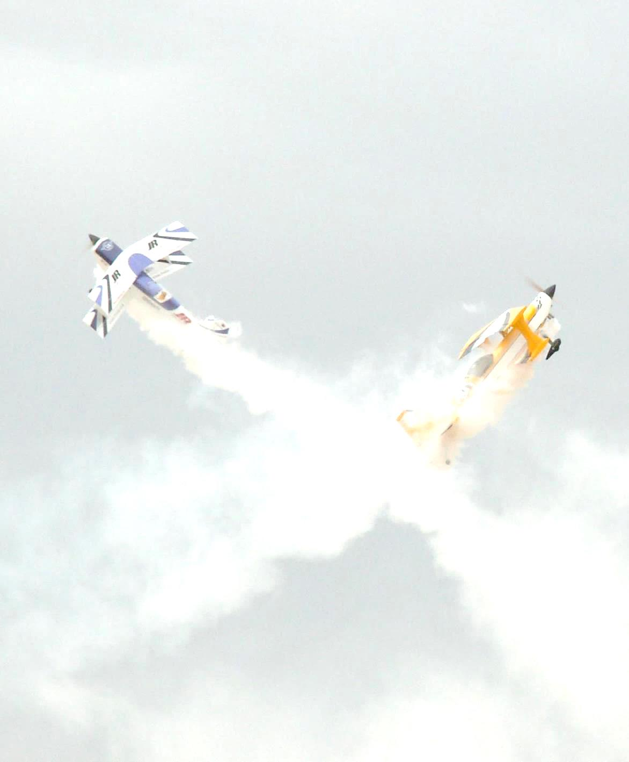

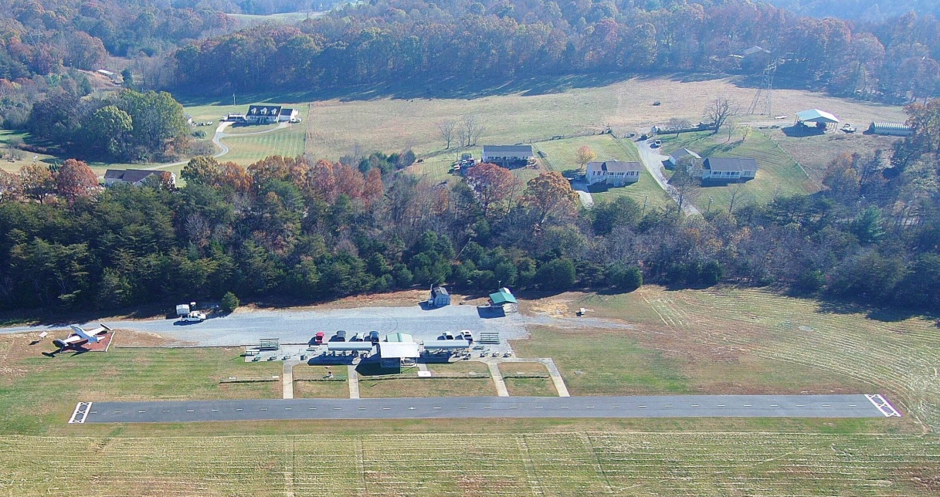
 | Johnson City Radio Controllers
Odom –Fennell Field
Our GPS Location is:
    Latitude: 36 degrees, 25 Minutes 6 Seconds North
    Longitude: 82 Degrees, 32 Minutes, 7 Seconds West
    Elevation : 1,713 ASL
JCRC Flies from a 500 foot long, 30 foot wide asphalt paved runway located on the Johnson City Landfill at Bowser Ridge. We have a 15 foot wide Grass strip on the far side of the runway and four concrete taxiways to the runway from flight stands on the near side. Our runway is oriented along a 20 degrees through 200 degrees magnetic line.
We have a covered Pavilion with observation seating, a covered Charging and meeting station, two covered aircraft preparation areas, fifteen flight tables, spectator bleachers, Porta Potty facility and 110 volt electrical service. Wi-Fi service is available under the Pavilion.
We also have a designated Control Line pad and Quad Copter flight area.
Located on our field is Johnson City’s Memorial Air Force T-33 Jet Trainer, which was restored and sited by our club.
With ample parking adjacent to the flight line, handicap parking and plenty of overflow parking, JCRC welcomes fliers, guests and the general public anytime the gates are open,. Our flying hours are 08:00 (8 AM) till Dusk, Monday through Sunday. Sunday morning is electric flying only
    We don’t fly when the lightning does!!   

Slide 2
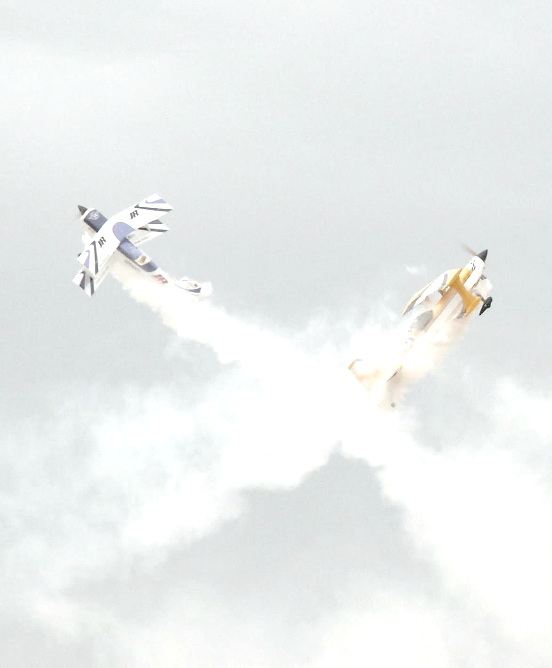


JCRC History
The Johnson City Radio Controllers started in February1986 when a group of hobbyists started a club to begin flying in a farm pasture in the Boones Creek, Tennessee area.
JCRC was formed, Officers elected, application made to become an AMA chartered Club, and the first year’s budget of $570.00 spent to prepare Farmer Walt Tittles’ field as the flying site.
In April, after preparing the site and seeding the runway, DISASTER struck!! It was a dry season, there was no water for the new grass, and then a fire destroyed the flying site. Left without a field, the newly formed JCRC began a new search for a site. Attempts to fly at the Sullivan County Industrial park met with the Industrial Commission’s decision“ the Piney Flats Industrial Park is not for recreational use””.
The hunt wore on and in July 1986, JCRC was finally able to begin flying, thanks to Mr. Decker, who owned the Old Decker Airfield in Jonesborough, TN. The club had a home until 1994 when the owner bowed to neighbor noise complaints and closed the field to model flying.
At about this time, Johnson City closed its Bowser Ridge Sanitary Land fill located off Eastern Star road. Aware of the closing and of the desire of many different groups to have access to the site, and using assistance from AMA, JCRC began the necessary exploration with Johnson City government personnel to make the case for Bowser Ridge housing a model Airport with JCRC as its custodial and resident Flying Club.
In October of 1994, Johnson City signed a five year lease with JCRC and the Tri-Cities Model Airport at Bowser Ridge became reality.
In 1996, a covered Pavilion and safety fences were installed and in 1996 JCRC officially dedicated the field as the Odom field after one of the founders and driving forces for the site, who passed away at age 53 the year before.
From 1994 through 1997, JCRC continued improvements on the field, from bare dirt flying to a struggling grass field flying.
In March 1997 the Johnson City Commissioners unanimously voted to allow and assist JCRC to install a 500 foot by 30 foot asphalt runway and by May the 12th, JCRC had two runways, one in grass and one paved with asphalt.
In 1998, JCRC began a restoration project on the Johnson City Memorial T-33, under the leadership of Ed Fennel. Construction of flying pads and taxiways was completed in late 1999. The T-33 Project was completed, the Plane sited on a pedestal at the field entrance and dedicated in June of 2000.
In 2017, our 20 year old runway was regraded and repaved, addressing ongoing settlement issues. It was rededicated July 22nd, 2017 as the Odom-Fennell Field in honor of two founding members, without whom there would be no JCRC or our current flying site.
In 2019, we added a 12 foot by 30 foot covered Sun Shade on the North side of the Flight Preparation area to provide overhead shelter for the Flight Prep Tables, as well as a rainwater catchment system to provide non-potable water for field maintenance. In 2021 we added a 12 foot by 20 foot shelter over the Chill and Grill preparation area to support our weekly Tuesday evening Grill party during the Summer months.
In 2022, we added a second Sun Shade on the South side of the Flight Preparation area over the Flight Prep Tables and installed electrical outlets on both shelters. In the Fall we sealed the runway surface.

Slide 3


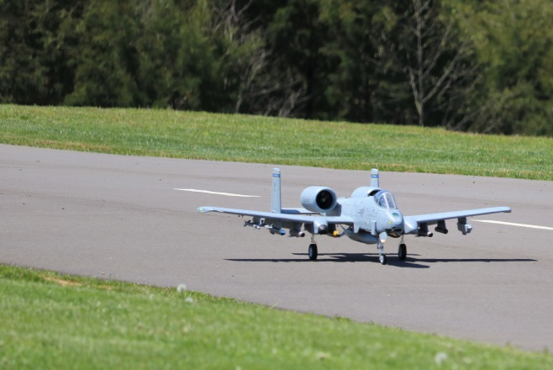
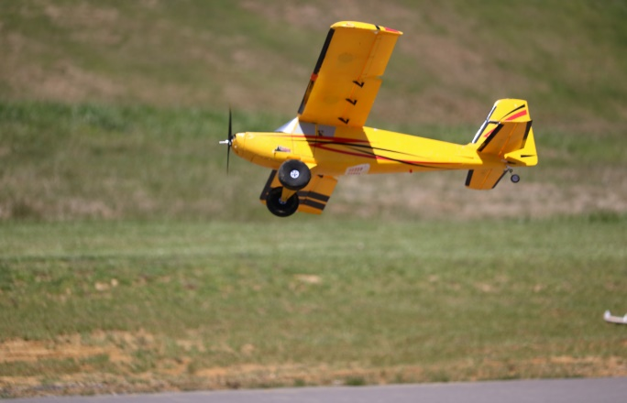
About Us
The Johnson City Radio Controllers is an AMA chartered club (AMA 2306) dedicated to safely engaging in the hobby of model aviation with a designated FRIA flying site.
JCRC was established with the goals of
  bringing new people into the hobby of building, learning about, and flying model aircraft,
  training new members to fly model aircraft,
  providing an opportunity to enjoy the hobby of aero modeling and,
  fostering fellowship with other modelers.
These objectives are met with the promotion of growth and participation by:
  Stimulating interest among the general public
  Instructional activities
  Assisting in the art, design, construction, and flying of model aircraft
  Hosting fun events with an emphasis on fun, camaraderie and respect
JCRC hosts several events throughout the year that are open to the public, including our Spring and Summer Fly–Ins at the Field, several Indoor Fly–In events hosted at various indoor venues in the Tri Cities, Our Halloween Fly – In and our annual January First, First Fly of the Year Freeze Out at the Field.
We are an inclusive organization, open to all who want to enjoy aero modeling providing an equal opportunity for all to participate in the leadership, support, growth and direction of our club.
We’ll put anyone to work!!
The Johnson City Radio Controllers’ Club is located at 120 Lancaster Road, Kingsport, TN 37663.
Visit us at both www.flyjcrc.com and HTTPS://www.facebook.com/groups/flyjcrc

